Slide 1



Education for
All Fundraising
Presentation by: Faith Bello

Slide 2
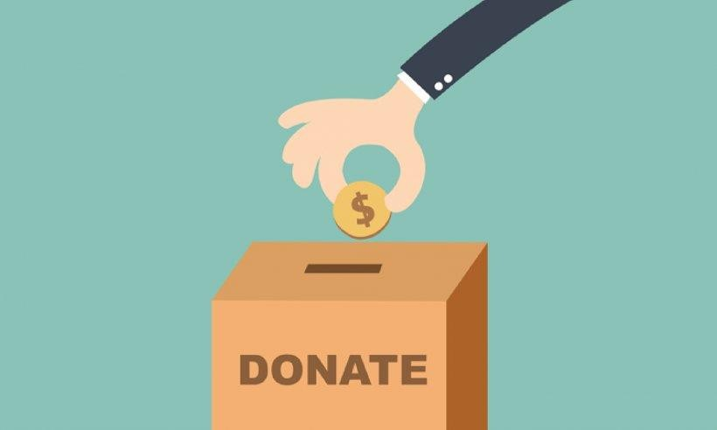
Education for All Fundraising Case Study
You’re a Data Analyst working for the charity, Education for All. You have been asked by the Head of Fundraising to present the data on donor insights and donation rates.
Within the Fundraising team, your objectives are to:
Increase the number of donors in your database
Increase the donation frequency of your donors.
Increase the value of donations in your database.
In two weeks your team is having a fundraising strategy meeting for the following year, and you need to present insights from the donation data to inform your fundraising strategy and increase donations.

Slide 3

Dataset
Use the datasets Donation_Data and Donor_Data below to answer the business problem.
Donation_Data
Contains the following data:
Donor_Data
Contains the following data:
id Donor ID
first_name Donor first name last_name Donor last name email Donor email address gender Donor gender job_field Donor job field donation Donation amount
state Donor state of residence (US)
shirt_size = Donor t-shirt size
id Donor ID
donation_frequency Frequency of donation university Donor University attended
car Donor car make
second_language Donor second language favourite_colour Donor favourite colour movie_genre Donor favourite movie genre
Download Donation_Data HERE
Download Donor_Data HERE

Slide 4

Queries to Consider
JOIN
ORDER BY
WHERE
BETWEEN
AND
OR
SUM()
COUNT()
AVG()
GROUP BY
HAVING

Slide 5

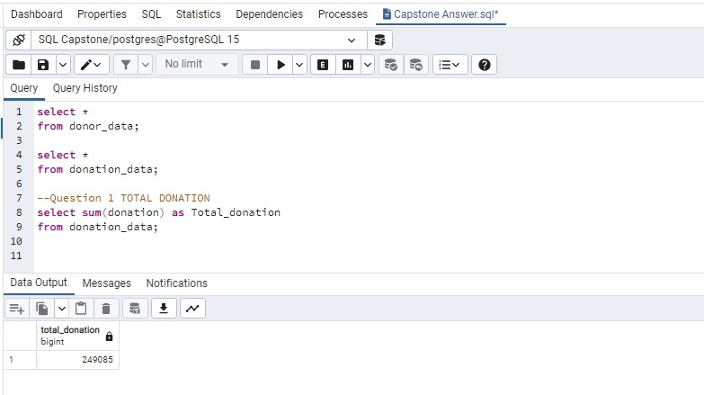
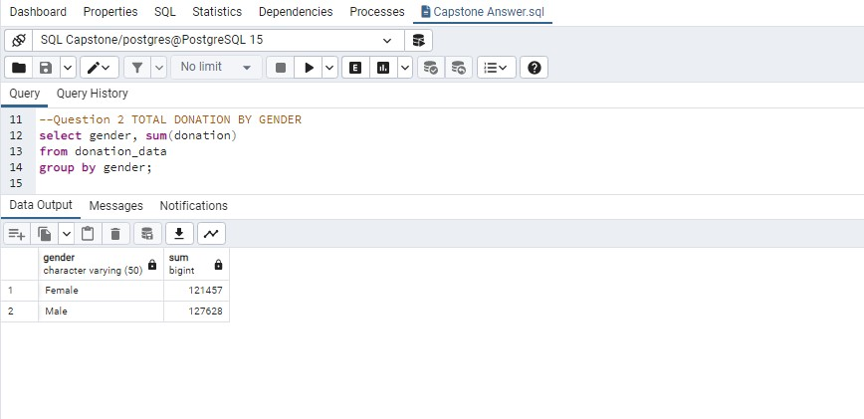
TOTAL DOANTION RECEIVED The total donation received was $249,085
TOTAL DONATION RECEIVED BY GENDER
The total donation received was
Male $ 121,457 Female $127,628

Slide 6

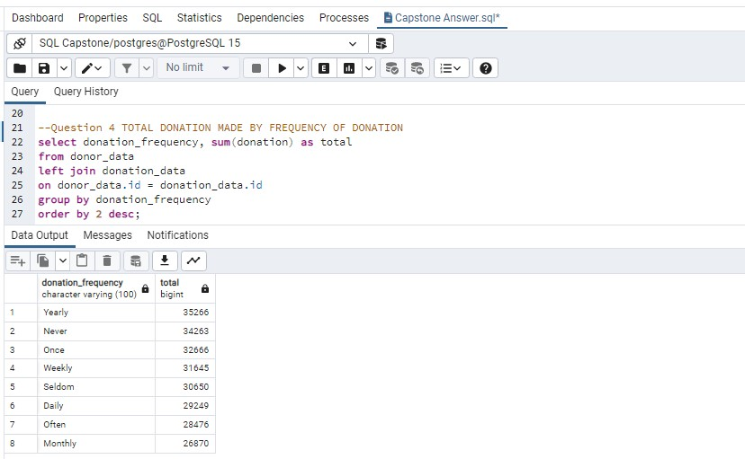
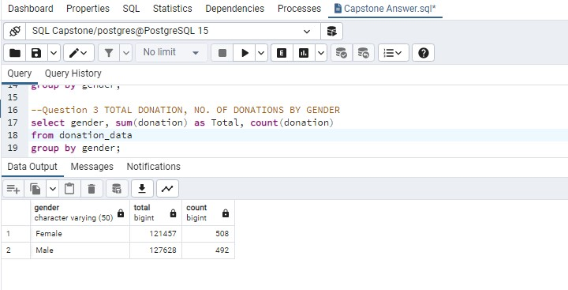
TOTAL DONATION AND NO OF DONATION RECEIVED BY GENDER
TOTAL DONATION MADE BY FREQUENCY

Slide 7

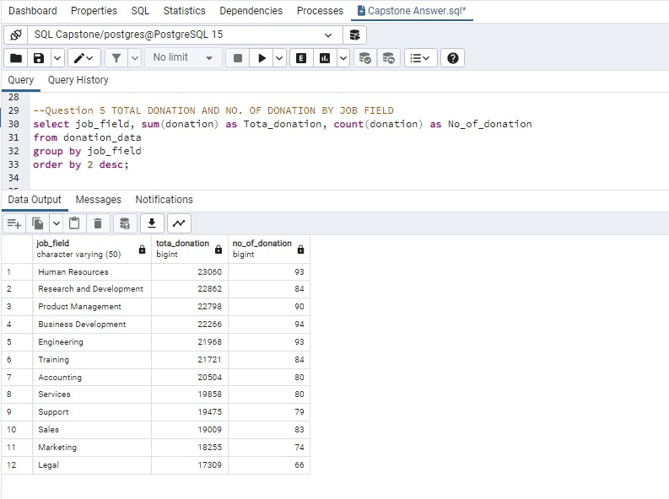
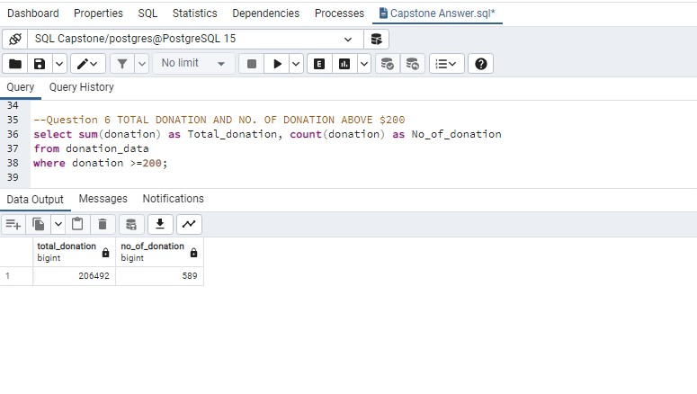
TOTAL DONATION AND NO OF DONATION RECEIVED BY JOB FIELD
TOTAL DONATION AND NO OF DONATION ABOVE $200

Slide 8

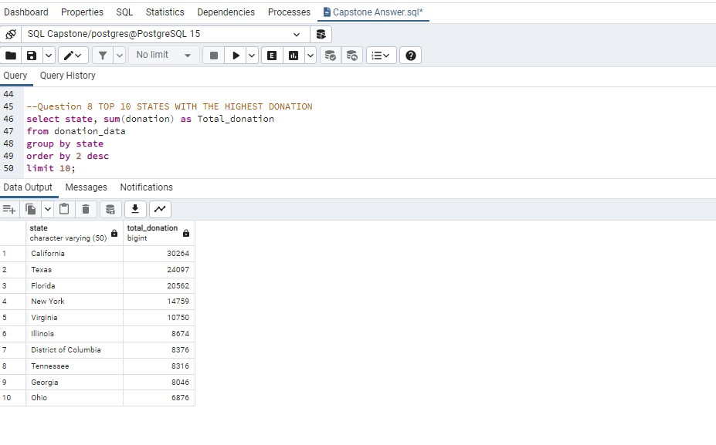
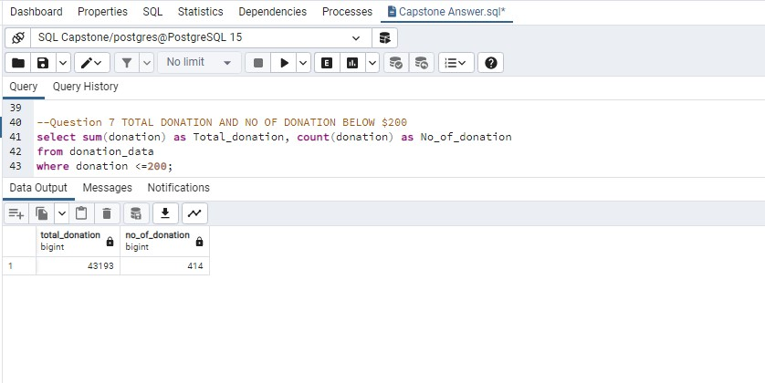
TOTAL DONATION AND NO OF DONATION BELOW $200
TOP TEN STATES WITH HIGHEST DONATION

Slide 9

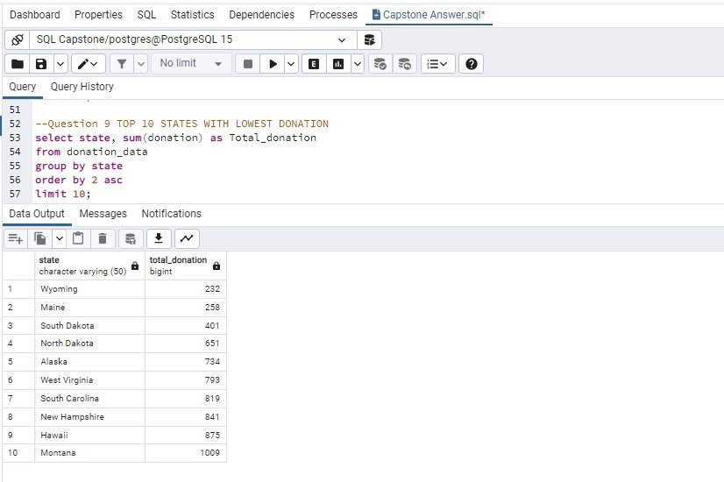
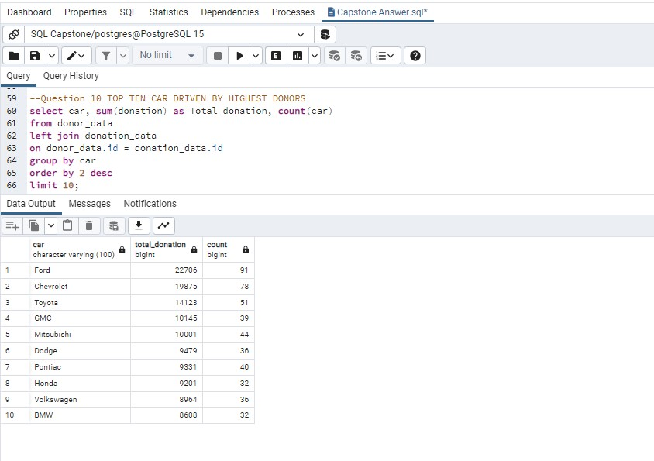
TOP TEN STATES WITH LOWEST DONATION
TOP TEN CARS DRIVEN BY HIGHEST DONORS

Slide 10
RECOMMENDATIONS
It was observed that Gender of donors and the university they attended did not determine the frequency or value of donations received.
To increase the number of donors in our database, we should target people who can afford to give yearly, weekly, once, etc, because such frequency of giving had an accumulated value above $30,000.
To increase the donation frequency of our donors, we should engage people who can give yearly and weekly donation.
To increase the value of donations in our database.
More efforts should be targeted at donors who will donate above $200 yearly or weekly.
Target states with donations above $6,000 such as California, Texas, Florida, etc.
Target individuals driving Ford, Chevrolet, Toyota, etc., as their donation is above $8,000.
Target individuals who are in the field of HR, R&D, Project Management, Business Development and Training.
Write specifically to donors who have been identified as donating above $200, appreciating them, and letting them understand the impact of their donations and the need to be consistent in impacting lives with their donations.

Slide 11

THANK YOU

